Slide 1
Post Abortal Care
Dr- Kay Zin Phu Wai

Slide 2
Possible Diagnoses for Woman seeking PAC
Missed miscarriage/abortion
Threatened miscarriage/abortion
Inevitable miscarriage/abortion
Incomplete miscarriage/abortion
Possible complications from an unsafe abortion
Complications resulting from previous PAC
Ectopic pregnancy
Hydatidiform mole

Slide 3
Uterine Evacuation Methods
Uterine evacuation removes contents of the uterus.
Recommended methods for uterine evacuation for incomplete abortion, uterine size under 12 weeks:
Vacuum aspiration (electric or manual)
Misoprostol for PAC (MPAC) or “medical methods”
Expectant management

Slide 4
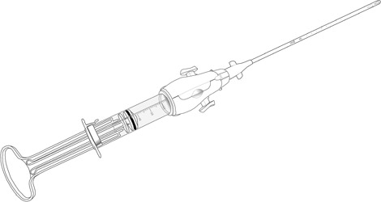
Ipas MVA Plus® with Ipas EasyGrip® Cannulae

Slide 5
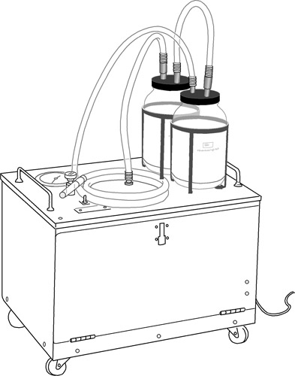
EVA Machine

Slide 6
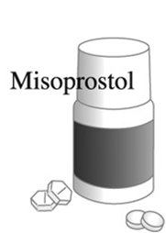
Medical Methods

Slide 7
Vacuum Aspiration (MVA or EVA)
Extremely safe
Few complications, especially when performed in the first trimester
Most studies show success in 98 to 100 percent of incomplete miscarriage/ abortion cases
Less costly when performed on outpatient basis under local anesthesia

Slide 8
Clinical Safety and Effectiveness of Misoprostol
Misoprostol through twelve weeks uterine size is safe
Misoprostol is effective in 91-99% of cases
For missed miscarriage/abortion, a single dose of misoprostol has 80% efficacy

Slide 9
Expectant Management
Definition: Allowing a miscarriage process to follow a natural course, while closely monitoring to ensure that all uterine contents are fully expelled
Only appropriate for women having an uncomplicated miscarriage
Many women who present with a miscarriage can be successfully managed without any intervention
At 7-14 days, 75-85% of miscarriages are complete

Slide 10
Advantages of VA over D&C or E&C
Lower risk of complications
Less cervical dilatation required
Can be performed as outpatient procedure
Decreased need for anesthetic drugs compared to D&C
Lower cost
Higher acceptability to women

Slide 11
Discussion before a Uterine Evacuation
Voluntary, informed consent
Procedure options (if both surgical and medical management are available)
Contraceptive counseling

Slide 12
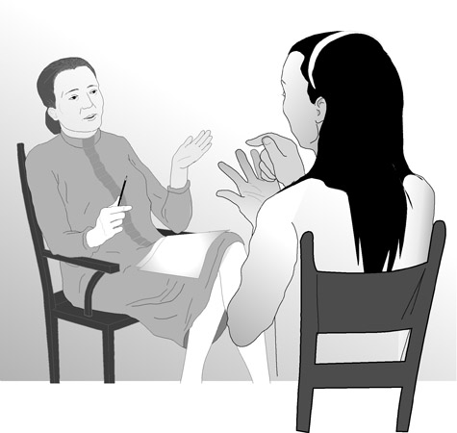
Communicate Effectively

Slide 13
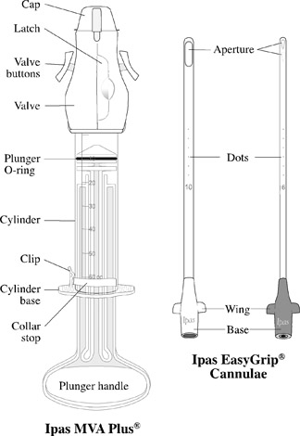
MVA Instruments

Slide 14
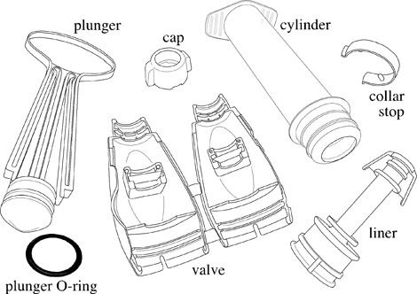

Slide 15
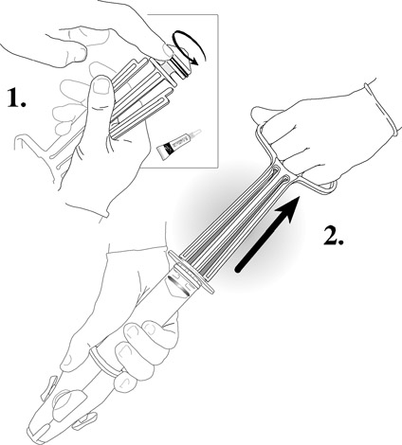

Slide 16
Intended use and indications:
Uterine aspiration or evacuation
Treatment of incomplete miscarriage/ abortion less than or equal to 12 weeks uterine size since LMP

Slide 17
Possible Complications
Vagal reaction
Incomplete evacuation
Uterine/cervical injury
Pelvic infection
Acute hematometra

Slide 18
MVA Procedure
Pain management- Anesthetic: paracervical block using lidocaine
- non steroidal analgesics(ibuprofen ,naproxen)
- Conscious sedation

Slide 19
Steps of the MVA Procedure
Prepare instruments.
Assist the woman.
Perform cervical antiseptic prep.
Perform paracervical block.
Dilate cervix.

Slide 20
Steps of the MVA Procedure (cont.)
Insert cannula.
Suction uterine contents.
Inspect tissue.
Perform any concurrent procedures.
Take immediate post-procedure steps, including instrument processing.

Slide 21
Step 1: Prepare Instruments
Check that the aspirator retains a vacuum.
Have more than one aspirator available.

Slide 22
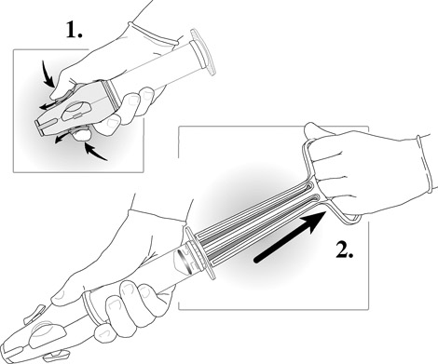
Create a Vacuum

Slide 23
Step 2: Prepare the Woman
Ensure pain medication is given at the appropriate time.
Administer antibiotics.
Ask the woman to empty her bladder.
Help her onto the table.
Ask for her permission to start.
Wash hands and put on appropriate barriers.
Perform a bimanual exam.
Select and insert speculum

Slide 24
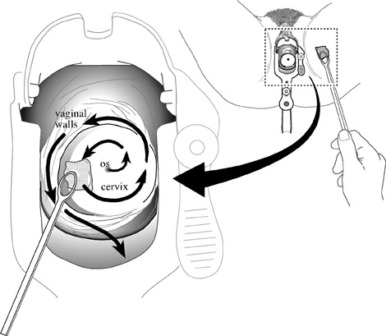
Step 3: Perform Cervical Antiseptic Prep

Slide 25
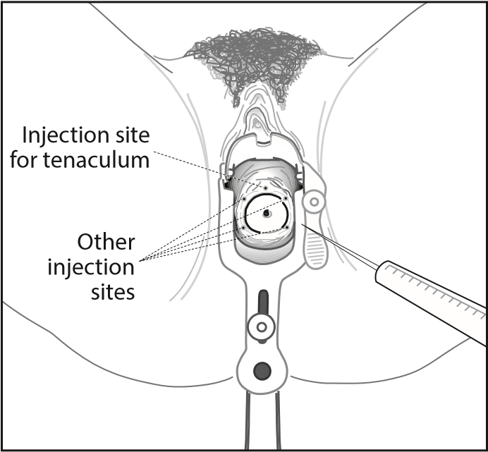
Step 4: Perform Paracervical Block
Usually 10 to 20mL of 0.5-1.0% lidocaine (always less than 200mg).

Slide 26
Step 5: Dilate Cervix
Dilatation required in most but not all cases.
Women with inevitable or incomplete abortion may require minimal or no dilatation.

Slide 27
Step 6: Insert Cannula
Gently apply traction to the cervix.
Rotate the cannula while gently applying pressure.
Insert cannula just past internal os.
Alternately, insert cannula slowly until it touches the fundus, then draw it back.

Slide 28
Step 7: Suction Uterine Contents
Attach charged aspirator to cannula.
Release buttons to start suction.
Gently rotate cannula 180 degrees in each direction.
Use a gentle “in and out” motion.
Do not withdraw cannula opening beyond external os.

Slide 29
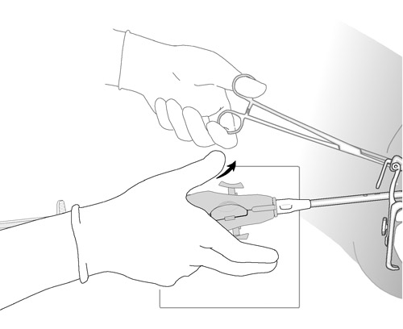
Release Buttons

Slide 30
Signs that the Uterus is Empty
Red or pink foam without tissue passing through cannula
Gritty sensation over surface of uterus
Uterus contracting around cannula
Increased uterine cramping or pain

Slide 31
Step 8: Inspect Tissue
Empty contents of aspirator into container.
Quantity and presence of POC.
Complete evacuation.
Molar pregnancy.

Slide 32
Step 9: Perform Any Concurrent Procedures
If POC inspection results satisfactory:
Wipe the cervix with swab to assess additional bleeding.
Perform concurrent procedure.

Slide 33
Step 10: Immediately Post-Procedure
Process or discard instruments.
Remove barriers and wash hands.
Reassure the woman that the procedure is finished.
Help her into a comfortable position.
Ensure she is escorted to the recovery area.
Record information about procedure.

Slide 34
Four Steps for Processing Instruments
Decontamination soak
Cleaning
Sterilization or high-level disinfection
Storage

Slide 35
Steps in Decontamination Soak
Fill a plastic container with solution.
Can use 0.5% chlorine solution.

Slide 36
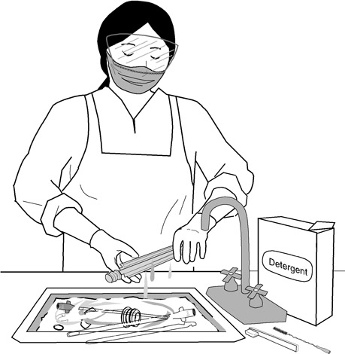
Clean Instruments Thoroughly

Slide 37
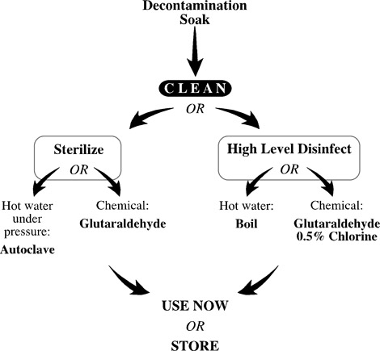

Slide 38
Statistics
Month | MVA | EVA | E & C | Medical Mx | Total
Janurary | 5 |  | 2 |  | 7
February | 10 | 1 | 3 |  | 14
March | 6 |  | 1 |  | 7
April | 4 | 1 | 2 |  | 7
May | 4 |  | 5 | 1 | 10

Slide 39
Thank You

